Slide 1





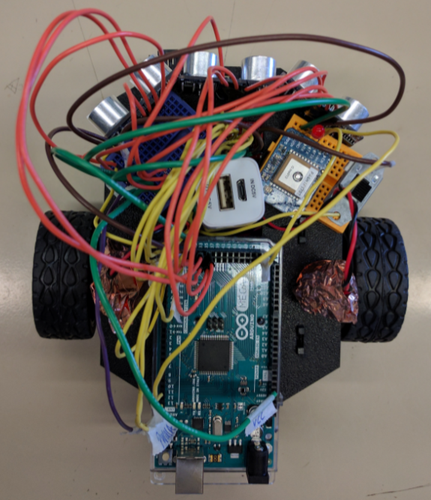
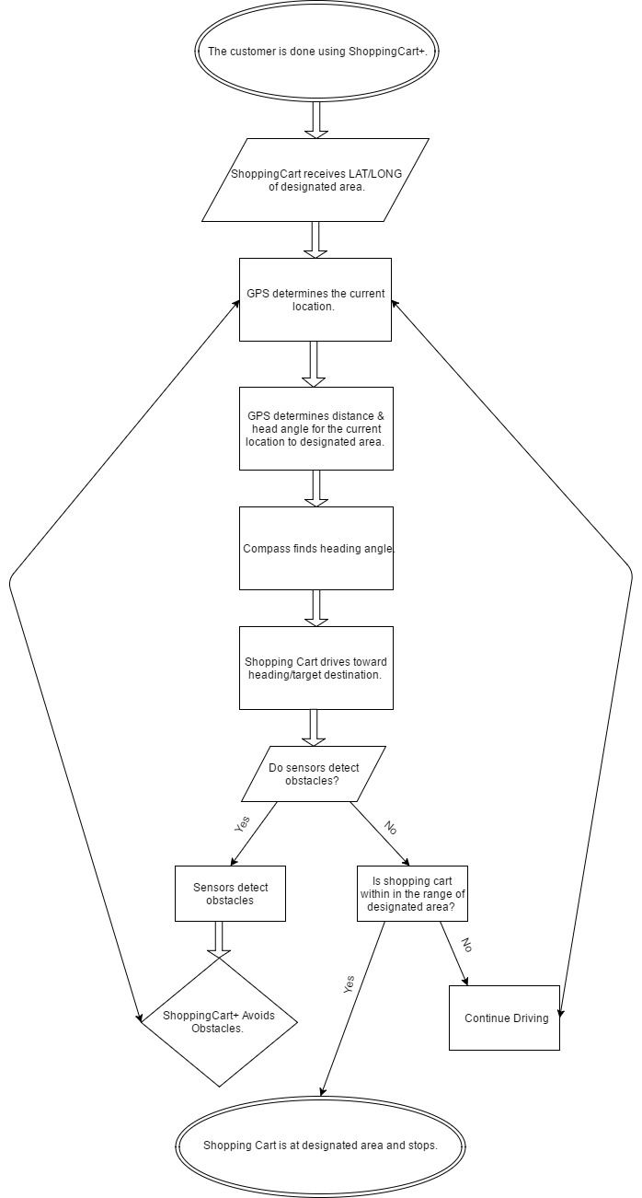
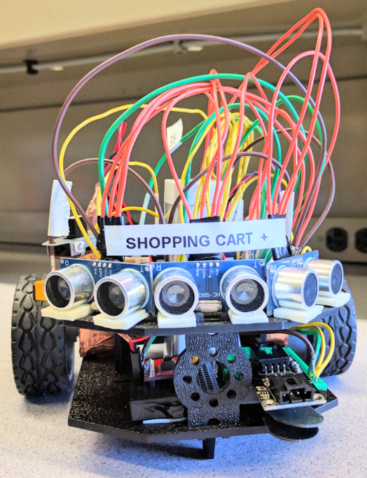
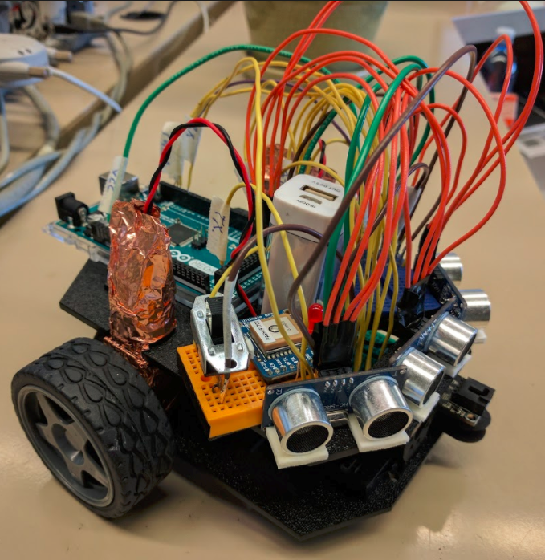
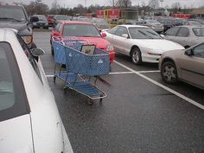
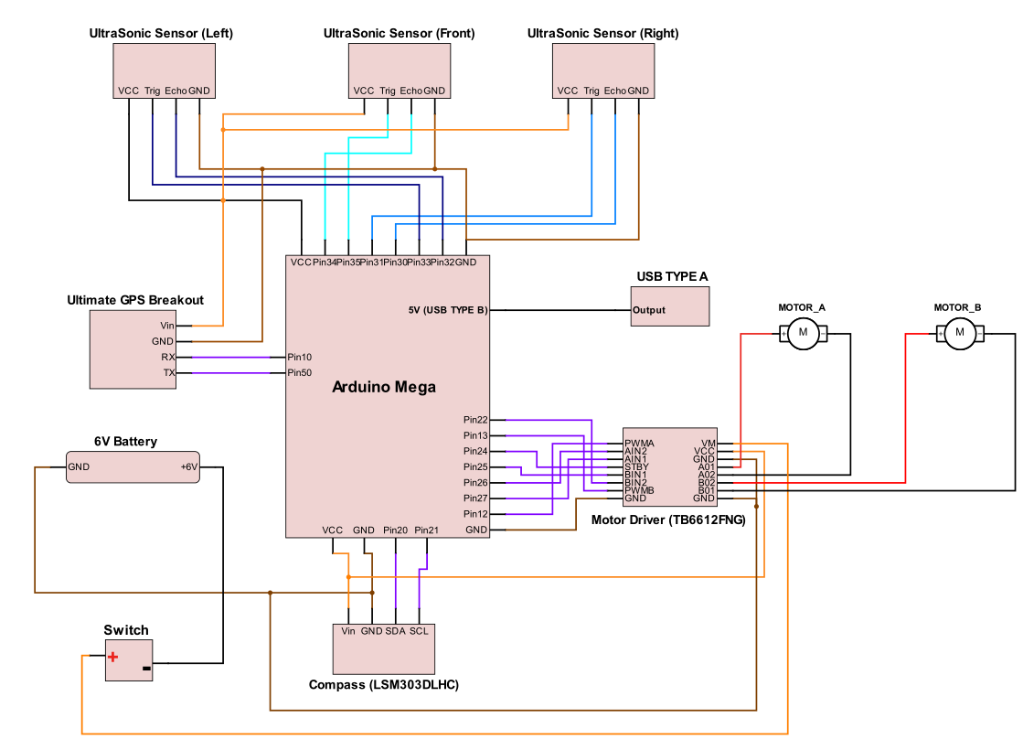

ShoppingCart+ System Abiel Garcia, Ankur Patel, Bilal Durrani BSEE Joseph Santacroce, MS Wentworth Institute of Technology
Abstract
Have you ever encountered a busy parking lot and the one spot you found has a shopping cart blocking the parking space? This project is solving the problem of abandoned shopping carts in undesirable locations in parking lots. The ShoppingCart+ is a prototype system that will allow a shopping cart to become self-guided. The ShoppingCart+ will identify its own geographical location and then drive itself to the assigned coordinates all, and while avoiding obstacles and collisions on its way to the specified coordinates.
Introduction
Objectives
To Identify the shopping carts geographical location through the coordinate system.
The cart must avoid obstacles while in the transition from its initial location to the assigned coordinates.
To reach the desired destination of the cart safely.
Components
Arduino Mega 2560
Ultimate GPS Breakout
Dual TB6612FNG Motor Driver
HMC5883 Magnetometer
HCSR04 Ultrasonic Sensor (3)
DC Motors (4)
6-Volt Battery
5-Volt USB power supply
Schematic Diagram
Flow Chart
Conclusion
Due to high-risk challenges, the decision to scale down the self-guided shopping cart was the most feasible option. The cart will travel to a designated area; this is done by sending coordinates of the designated area through a laptop. The cart will avoid obstacles during its journey to the designated coordinates.
References
Nedelkovski, Dejan.” Ultrasonic Sensor HC-SR04 and Arduino Tutorial” Howtomechatronics, July 26, 2015
"SparkFun Motor Driver - Dual TB6612FNG (1A)." Learn at SparkFun Electronics. N.p., n.d. Web. 09 Apr. 2017. Earl, Bill “LSM303 Accelerometer + Compass Breakout” Adafruit, 10:16:47 PM October 4, 2016.
“Sensor Module: 3-axis Accelerometer and 3-axis Magnetometer” (n.d.): n. pag. LSM303DLH. Sparkfun, 9 Dec. 2017. Web. 9 Apr. 2017
Warren, John-David, Josh Adams, Harald Molle, and Guilherme Martins. Arduino Robotics. New York, NY: Apress, 2011. Web.
“Arduino Lessons” YouTube, uploaded by Paul McWhorter, 5 March 2017, https://www.youtube.com/playlist?list=PLGs0VKk2DiYx6CMdOQR_hmJ2NbB4mZQn-.
Santacroce, Joseph “ENGINEERING SENIOR DESIGN II - ENGR 5500 - 03”, Dobbs Hall 202. Wentworth Institute of Technology, Boston Massachusetts. Lecture/Weekly Meetings
Keathley, Phillip Donnie “ENGINEERING SENIOR DESIGN II - ENGR 5500 - 03”, Dobbs Hall 202. Wentworth Institute of Technology, Boston Massachusetts. Meeting
Yang-Keathley, Yugu “ENGINEERING SENIOR DESIGN II - ENGR 5500 - 03”, Dobbs Hall 202. Wentworth Institute of Technology, Boston Massachusetts. Meeting
Diecidue, Joseph “ENGINEERING SENIOR DESIGN II - ENGR 5500 - 03”, Dobbs Hall 202. Wentworth Institute of Technology, Boston Massachusetts. Meeting
Gagne, Justin “Student in Computer Science Department at WIT”, Wentworth Hall 209. Wentworth Institute of Technology, Boston Massachusetts. Meeting
Abandon shopping carts
causes congestion,
frustration, and traffic
related problems.
A parking lot has
traveling pedestrians,
cars, and employees
collecting shopping
carts; which all take
place simultaneously. This project will be dealing with a shopping cart that will be avoiding obstacles, traveling from one location to another with little assistance.

